Slide 1

TARP Project MVP
A cloud-native cybersecurity platform for simulating and detecting Command-and-Control attacks through advanced AI/ML analysis.

Slide 2

Core Capabilities Overview
C2 Attack Simulation
AI-Powered Detection
Generate realistic Command-and-Control attack traffic to test detection systems.
Leverage machine learning algorithms to identify suspicious patterns in real-time.
Secure Access
Cloud-Native Design
Role-based authentication ensures only authorized users can access the platform.
Kubernetes-orchestrated architecture enables seamless scaling and deployment.

Slide 3

C2 Attack Simulation
Realistic Threat Scenarios
The sensor simulator microservice generates authentic Command-and-Control attack traffic and events, mimicking various attacker behaviors.
Multiple attack pattern simulations
Configurable threat scenarios
Real-time event generation
Comprehensive testing capabilities

Slide 4
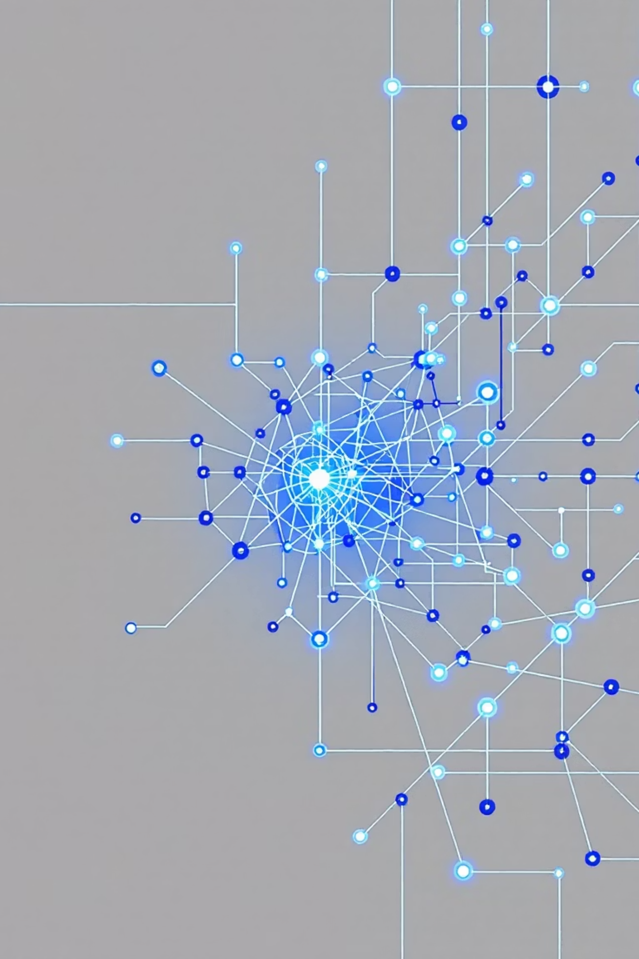




Anomaly Detection & Threat Analysis
Data Ingestion
Collect simulated or real traffic data
AI/ML Analysis
Model-service processes patterns using advanced algorithms
Threat Detection
Identify anomalies and suspicious C2 activity
Real-Time Results
Deliver actionable insights for monitoring

Slide 5

Secure Authentication System
User Authentication
Role-Based Access Control
The auth-service ensures only authorized personnel can access the dashboard and control critical services.
Extensible RBAC framework allows granular permission management across different user roles and responsibilities.
Security First
Built-in protection mechanisms safeguard sensitive operations and prevent unauthorized system access.

Slide 6
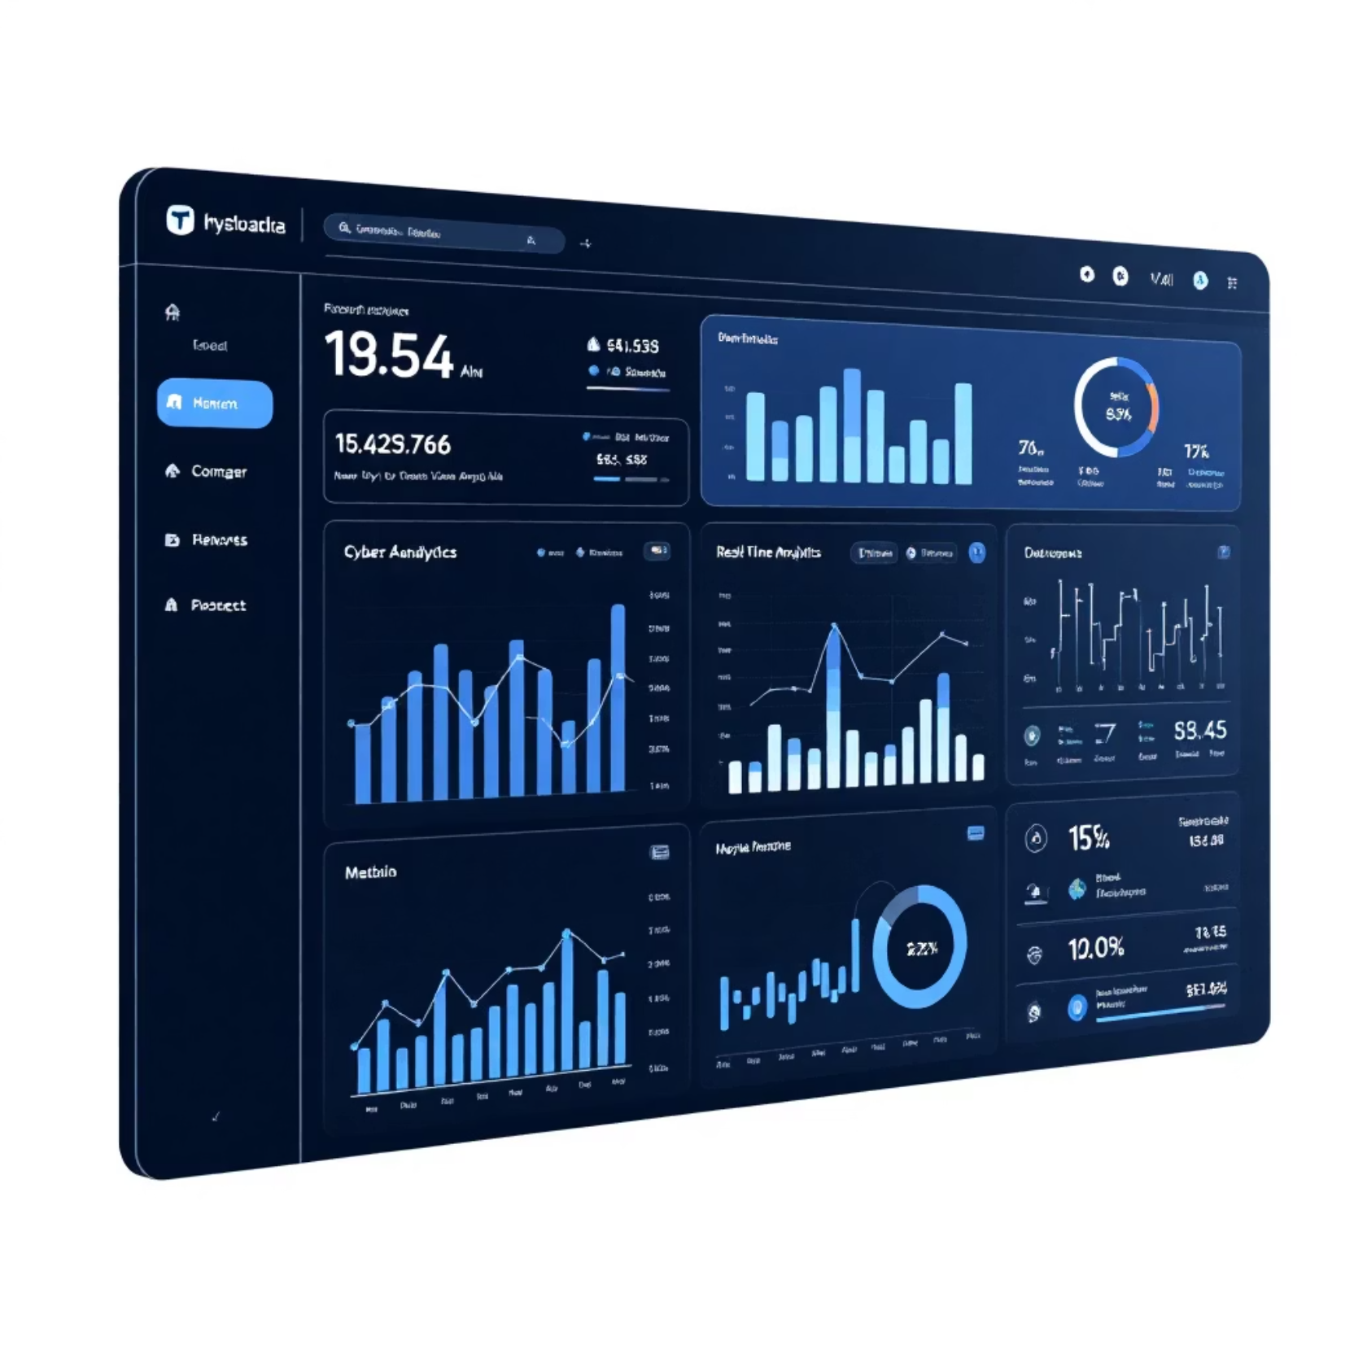
Interactive Web-Based UI
Comprehensive Control Center
Visualize ongoing simulations and alerts
Monitor system status in real-time
Trigger simulations with intuitive controls
View analytics and threat intelligence
Seamless API integration for responsive experience

Slide 7
Kubernetes-Native Deployment
Containerized Services
Easy Scaling
All microservices are containerized for consistent deployment across environments.
Kubernetes orchestration enables automatic scaling based on demand and workload.
Fault-Tolerance
Network Control
Built-in resilience mechanisms ensure high availability and system reliability.
Deployments, Services, and policies manage secure internal communication.

Slide 8

API Integration & Extensibility
External Access
Automation Ready
Platform Extension
Backend services expose robust APIs for integration with external systems and platforms.
Enable automated workflows, continuous monitoring, and seamless system orchestration.
Integrate into larger cybersecurity ecosystems and enterprise security frameworks.

Slide 9
Scalable Architecture
Cloud Deployment
Local Development
Deploy seamlessly to any cloud provider with Kubernetes support.
Run fully in Minikube for testing and development environments.
Easy Extension
Microservice Independence
Add new detection models, sensors, or frontend features without disrupting existing services.
Each service operates independently for maximum flexibility and maintainability.

Slide 10

TARP: The Future of C2 Detection
Key Advantages
AI-powered real-time threat detection
Realistic attack simulation capabilities
Cloud-native, scalable architecture
Secure, role-based access control
Extensible microservices design
Comprehensive monitoring dashboard
Ready to deploy in local or cloud environments with full Kubernetes orchestration.

